Slide 1
Machine Learning Analysis of Employee Burnout
Menard Cayabyab
Kenneth Chang
Clair Dean
Sohaib Khan

Slide 2

Primary Questions
What factors correlate more strongly with burnout?
Are there any correlations among burnout factors?
How effectively can we predict burnout (with this data and ML)?

Slide 3
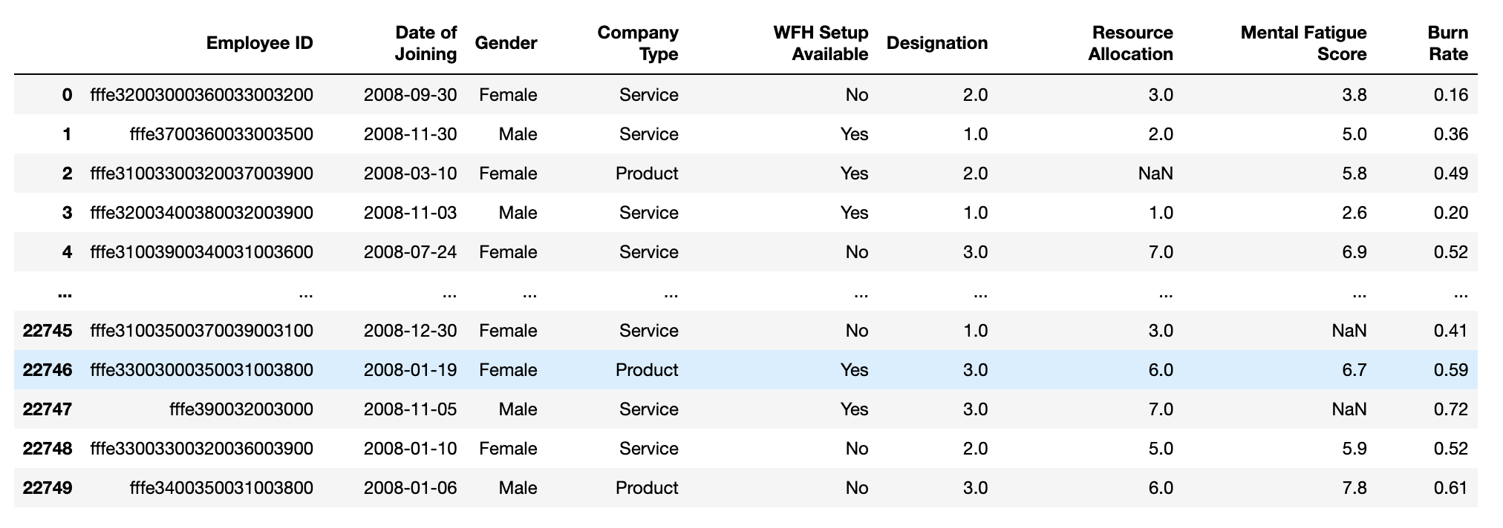
The Dataset
Dataset sourced from Kaggle: “Are Your Employees Burning Out?” and from a HackerEarth machine learning challenge (October - November, 2020)

Slide 4
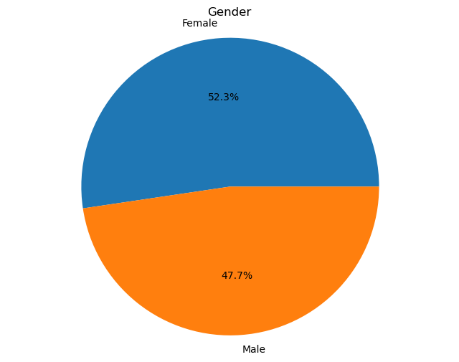
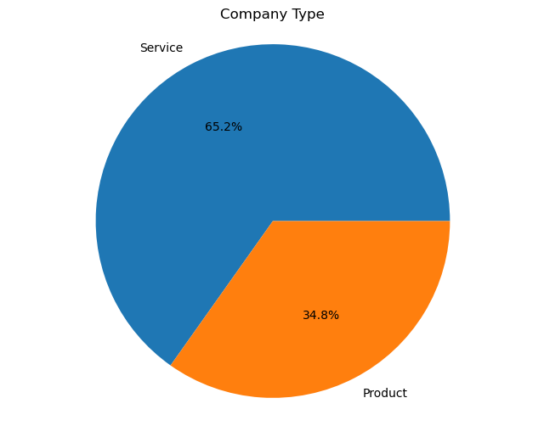
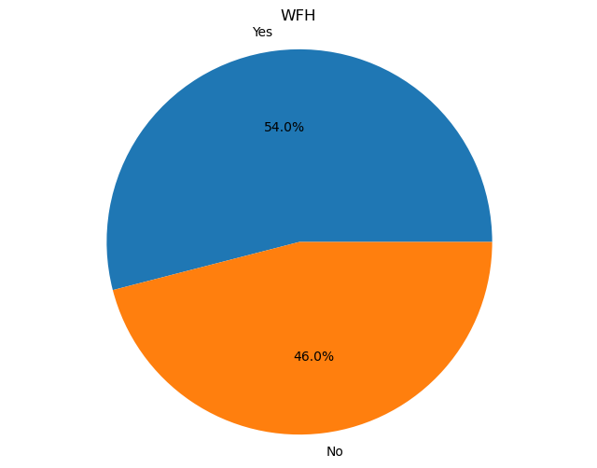
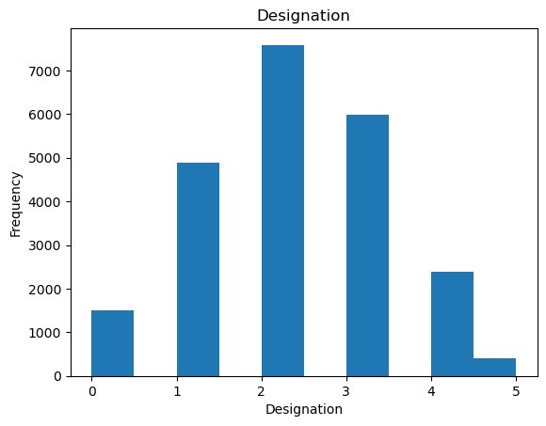
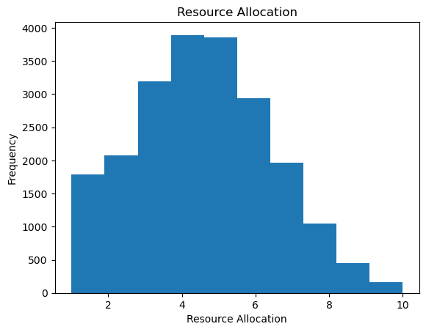
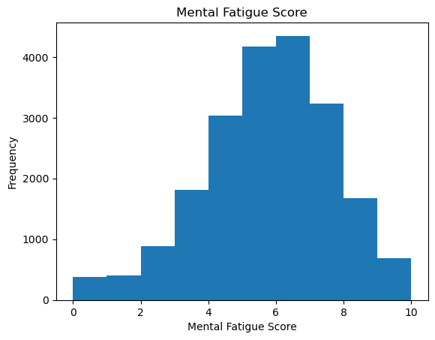
The Data, At a Glance:
Notes:
(Describe each of the factors that we’re looking at: Gender, Company Type, Work From Home availability, “designation”, “resource allocation”, “mental fatigue score”, and “burn rate”)

Slide 5
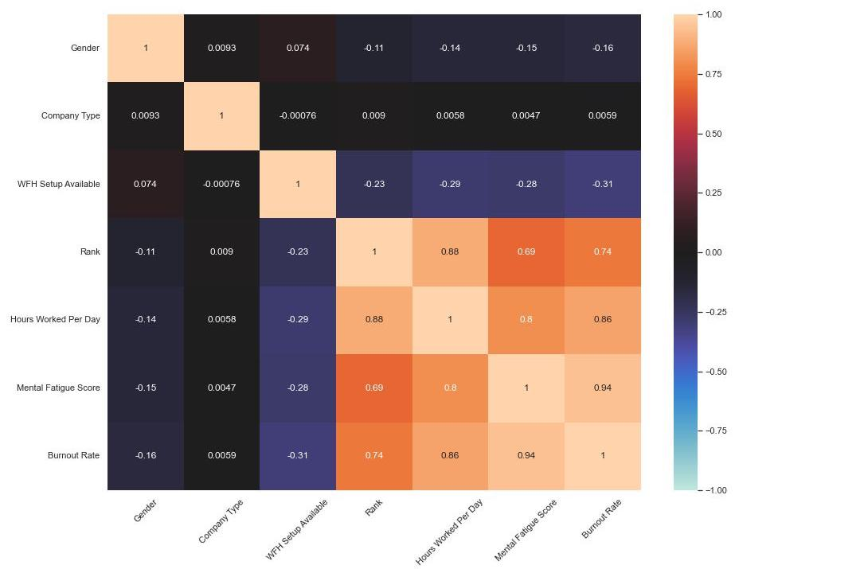
How strongly do these factors correlate?
Based on the training data:
An employee’s rank, the number of hours worked per day, and their mental fatigue have the strongest positive correlations with burnout
The availability of working from home (WFH) does have a negative correlation with burnout, although not as strongly
Company type and gender do not have very strong correlations
Notes:
(Warm colors indicate a positive correlation, cool colors indicate a negative correlation. Darker shades indicate a weaker correlation, lighter tints indicate a stronger correlation)

Slide 6
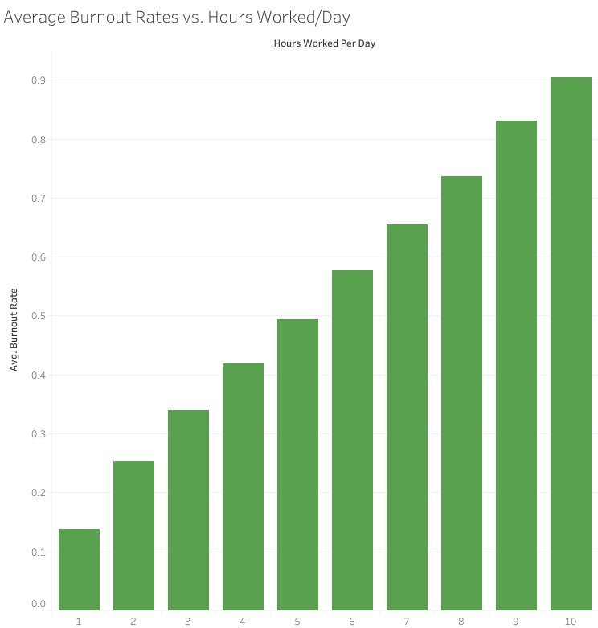
Exploring Burnout Factors:
Hours Worked
per Day

Slide 7
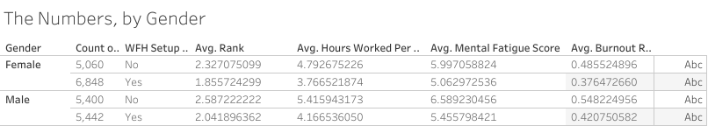
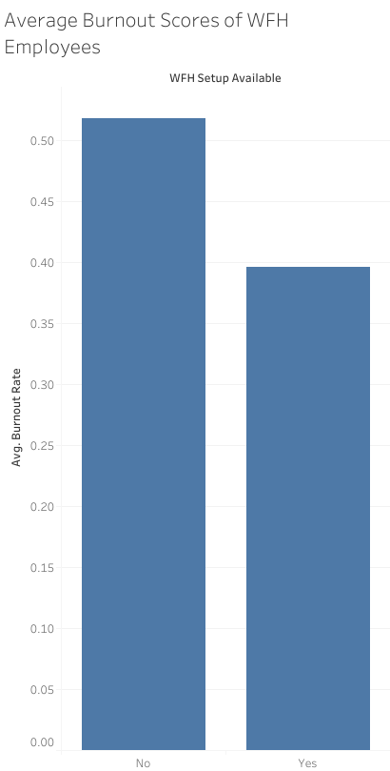
Exploring Burnout Factors: Gender, WFH
Overall, female employees report lower burnout rates and mental fatigue scores, compared to male employees
Overall, they also seem to work fewer hours and are lower in the corporate hierarchy (rank) than male employees - both of which correlate positively with higher burnout scores
There is a slight decrease in burnout rates (and all other associated factors) when employees are given the option to work from home.

Slide 8
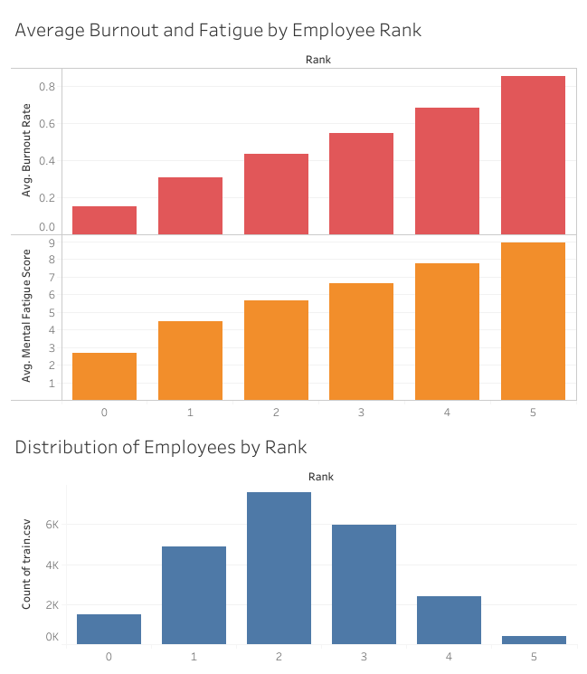
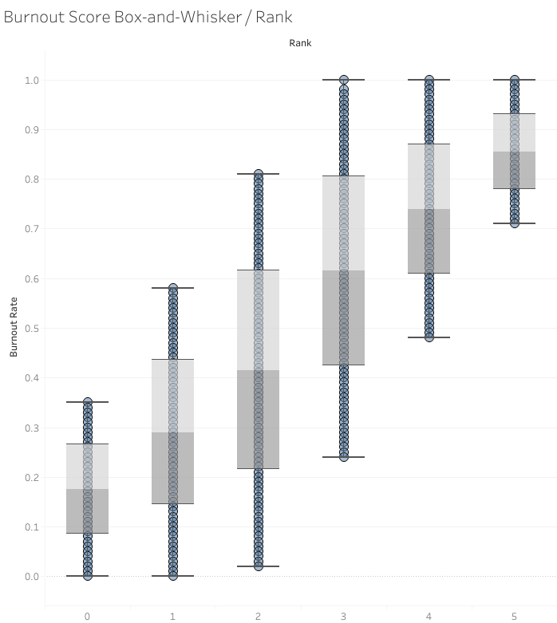
Exploring Burnout Factors:
Employee Rank
Notes:
Overall there is a positive correlation between employee rank and high mental fatigue scores/burnout rates, although this correlation may be skewed due to the distribution of employees by rank and the variation in burnout scores by rank.
Looking at the histogram on the bottom left, there are fewer higher ranked employees (ranks 4 and 5), while lower and mid-ranked employees (ranks 1-3) are very well-represented. This does reflect a normal distribution, but it can skew the data.
Looking at burnout scores by rank using a box and whisker plot, on the right, the range in variation is much more apparent. Employees in ranks 1 through 3 show a very wide variation when it comes to their burnout scores, while employees at rank 5 show very little variation. The differences in size for these sub-populations can affect how applicable/generalizable this correlation can be in the real world.

Slide 9

How can we predict burnout?
Based on the visualizations and historical data through Tableau and Pandas to showcase the data collected, we can then predict and answer the questions for this project :
Machine Learning .ipynb which runs our dataset at approx 92% accuracy rate with visualizations corresponding to burnout factors in scatterplot, bar graph, and heatmap
Tableau and Jupyter/Colab notebooks showcasing various visualizations which correlate burnout factors and their relationships with each other.
Survey made in HTML which better gauges burnout with questions relating to the burnout factors mentioned above

Slide 10
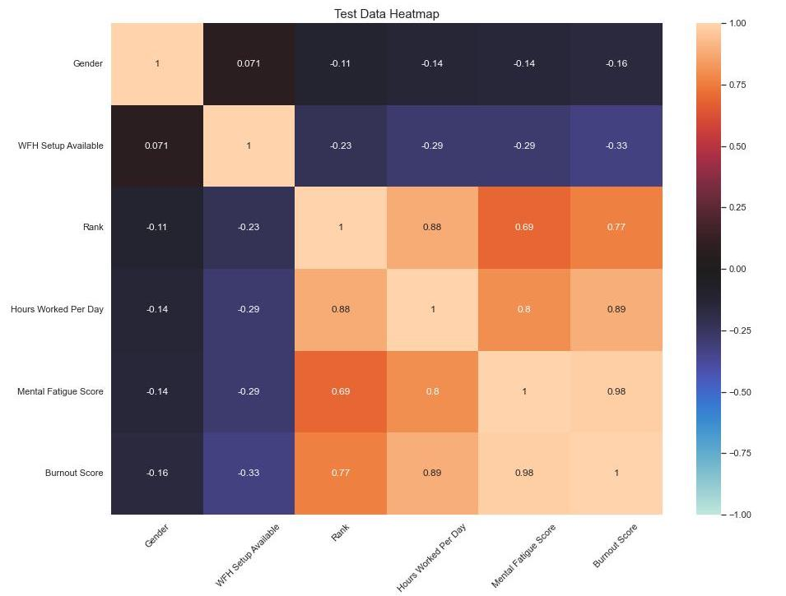
How effectively can we predict burnout (with this dataset and machine learning)?
The dataset also had a testing subset in its own .csv file, without burnout rate data.
After running this testing data through the model and generating a heatmap based on the results, the correlations between variables are very similar to those of the training subset.
Notes:
(Warm colors indicate a positive correlation, cool colors indicate a negative correlation. Darker shades indicate a weaker correlation, lighter tints indicate a stronger correlation)

Slide 11
Thank you

